Slide 1

RESEARCH METHODOLOGY IN Psychology
BY: AQSA FAYYAZ
Lecturer
(Science and Humanities)
FAST - National University of Computer & Emerging Sciences

Slide 2
LEARNING OUTCOMES
What are scientific methods?
Types of research methods
Variables
Research Designs
Ethical Considerations in Research

Slide 3

What is research?
Systematic Inquiry: Research follows a structured approach to collect and analyze information.
Knowledge Expansion: It seeks to generate new insights, confirm existing theories, or explore different areas.
Problem Solving: Research can address specific questions or issues, leading to practical solutions or advancements in a field.

Slide 4
Types of Research
Basic Research: Also known as fundamental or pure research, it focuses on expanding theoretical knowledge without immediate practical application. For example, studying cognitive processes to understand how memory works.
Applied Research: It aims to solve specific, practical problems and often involves direct application of theories. For instance, developing new educational strategies based on cognitive research.

Slide 5
Scientific methods
1. Observation
2. Formulating a Hypothesis: Proposing a tentative explanation or prediction based on the observations. A hypothesis should be specific, testable, and falsifiable.
3. Designing an Experiment:
Planning how to test the hypothesis, including selecting variables, controls, and methods for data collection.

Slide 6
Variables:
Independent Variable: The variable that is manipulated or changed in the experiment.
Dependent Variable: The variable that is measured or observed to assess the effect of the independent variable.
Control Variables: Factors that are kept constant to ensure that any changes in the dependent variable are due to the manipulation of the independent variable.

Slide 7
Research Topic | Independent Variable | Dependent Variable
Plants grow faster in warmer temperatures. | Temperature | Plant Growth
To what extent does traffic affect a person's mood? | Traffic | Mood
People walk slower after drinking coffee. | Drinking Coffee | Walking Speed
Notes:
Eg: In a study on the relationship between screen time and sleep problems, screen time is the independent variable because it influences sleep (the dependent variable).

Slide 8
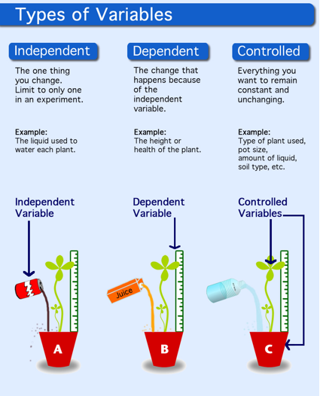

Slide 9
4. Conducting the Experiment
Execution: Performing the experiment according to the design, ensuring accurate and precise measurements and controls.
Data Collection: Systematically recording the results of the experiment.
5. Analyzing Data
Data Analysis: Using statistical methods or qualitative analysis to interpret the results and determine if they support or refute the hypothesis.
Comparison: Assessing the data against the predictions made by the hypothesis.

Slide 10
6. Drawing Conclusions
Conclusion Formulation: Based on the data analysis, determining whether the hypothesis is supported or rejected.
Implications: Discussing the significance of the findings, potential impacts, and how they relate to existing knowledge.
7. Reporting Results
Documentation: Writing detailed reports or papers that include the methodology, results, and conclusions. This often includes sharing the research in scientific journals or presentations.
Peer Review: Submitting the work for review by other experts in the field to validate the findings and methodology.

Slide 11
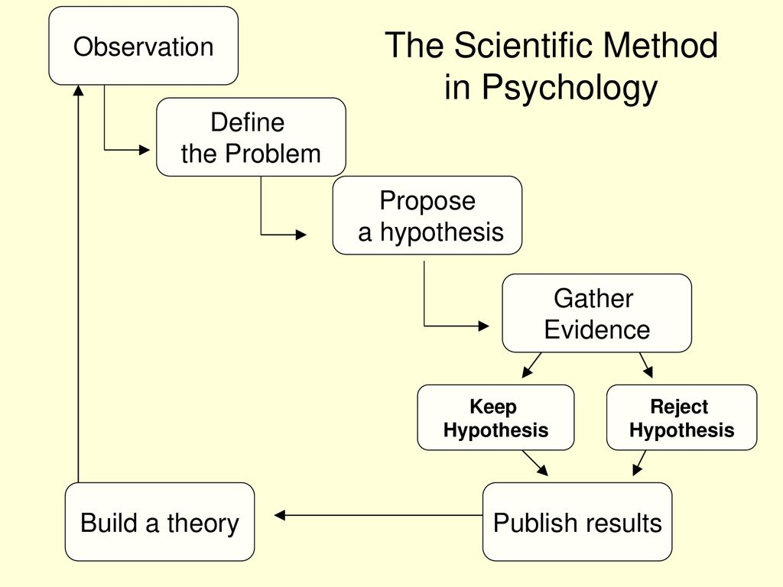

Slide 12
Research Process
Identifying a Problem or Question: Defining a clear and focused research question or problem.
Conducting a Literature Review: Reviewing existing research to understand what has already been discovered and to refine the research question.
Designing the Study: Developing a plan that includes choosing a research design, methods, and tools for data collection.
Collecting Data: Gathering information through various methods such as experiments, surveys, interviews, or observations.
Analyzing Data: Using statistical or qualitative methods to interpret the data and draw conclusions.
Reporting Results: Presenting findings in a structured format, often including a discussion of implications and recommendations.

Slide 13
Research Methodologies
Qualitative Research: Focuses on understanding phenomena from a subjective perspective, often using methods like interviews, thematic analysis and case study researches
Quantitative Research: Involves measuring and analyzing numerical data to identify patterns, relationships, or causal effects, using statistical techniques.
Mixed Methods Research: Combines both qualitative and quantitative approaches to provide a comprehensive analysis.

Slide 14
Research Designs:
Experimental Designs:
Purpose: To determine causality by manipulating one or more independent variables and observing the effect on dependent variables.
Key Features:
Control Group: A group that does not receive the experimental treatment, used for comparison.
Random Assignment: Participants are randomly assigned to either the experimental or control group to minimize biases.

Slide 15
1. A researcher with a sample of 100university students might assign half of them to write about a traumatic event and the other half write about a neutral event
2. Perform a study to look at whether sleep deprivation impairs performance on a driving test.

Slide 16
Non-Experimental Designs:
Purpose: To describe and explore relationships or phenomena without manipulating variables.
Key Features:
Observational: Data is collected without interference or manipulation.

Slide 17
Examples:
1.Correlational Studies: Examines the relationship between two or more variables to determine if they are associated.
Eg: 1. Relationship between alcohol consumption and unemployment
2. Relationship between academic performance and career success
3. Relationship between income levels and crime.
2. Cross-Sectional Studies: Observes variables at a single point in time, providing a snapshot of a phenomenon.
E.g.: 1. A data collection of smoking habits and lung cancer incidence in a given population.
2. Research of stress levels in college students in various years of study.
(Freshman, sophomore, etc.)

Slide 18
3. Longitudinal Studies: Follows the same subjects over time to observe changes and developments.
Eg: 1. Researchers repeatedly examine the same individuals to detect any changes that might occur over a period of time
2. A study conducted to understand the similarities or differences between identical twins who are brought up together versus identical twins who were not.

Slide 19
Descriptive Designs:
Purpose: To provide a detailed account of a phenomenon or population.
Key Features:
Descriptive Data: Provides a detailed description without attempting to determine cause-and-effect relationships.
Examples:
Case Studies: In-depth analysis of a single subject or a small group.
Surveys: Collecting data from a large number of people through questionnaires or interviews.
Observational Studies: Watching and recording behavior in natural settings without intervention.

Slide 20
Exploratory Designs:
Purpose: To explore new areas where little information exists or to generate hypotheses for future research.
Key Features:
Flexibility: Often uses qualitative methods to gather initial insights.
Examples:
Focus Groups: Group discussions to explore perceptions, opinions, and ideas.
Interviews: In-depth individual interviews to gather detailed personal perspectives.

Slide 21
Validity and reliability
Validity
Validity is about the accuracy of a measurement—whether it measures what it’s supposed to measure
Example: If a test is designed to measure math skills, its validity is high if it includes questions on math problems rather than questions on unrelated topics like history.
Reliability
Reliability is about consistency—whether the measurement produces stable and consistent results.
Example: If you take the same math test twice and get similar scores both times, the test is considered reliable.

Slide 22
Ethical Considerations
Informed Consent: Ensuring participants are aware of the research and agree to participate voluntarily.
Confidentiality: Protecting the privacy of participants and their data.
Integrity: Conducting research honestly and accurately, avoiding fabrication or falsification of data.

Slide 23
Applications of Research
Academic and Scientific: Contributing to the body of knowledge in various fields such as psychology, medicine, or sociology.
Professional and Practical: Informing practices and policies in areas like education, healthcare, or business.

